Slide 1
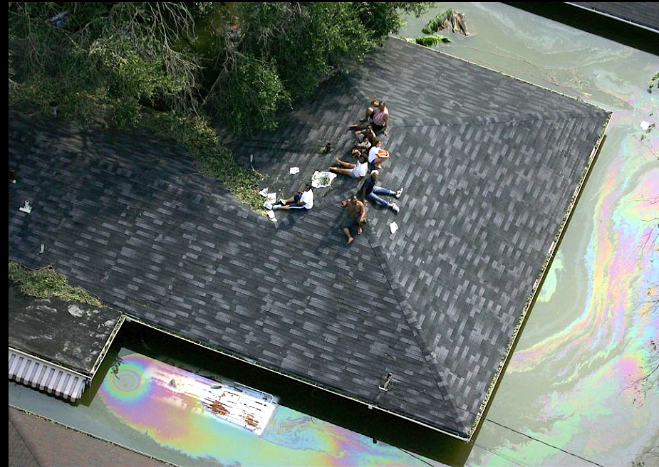
Environmental Justice & Equity of Flooding
Team_Global Flood Equity XR
Hoang Tao _PhD ABD UNO
Kanupriya Tiwari_PhD ABD UQ
Patrick Kalonde_ GR SCSU
Artne Nguyen_UG UCLA
Trung Vu_UG UCLA
CGI & Howard Hackathon UC

Slide 2
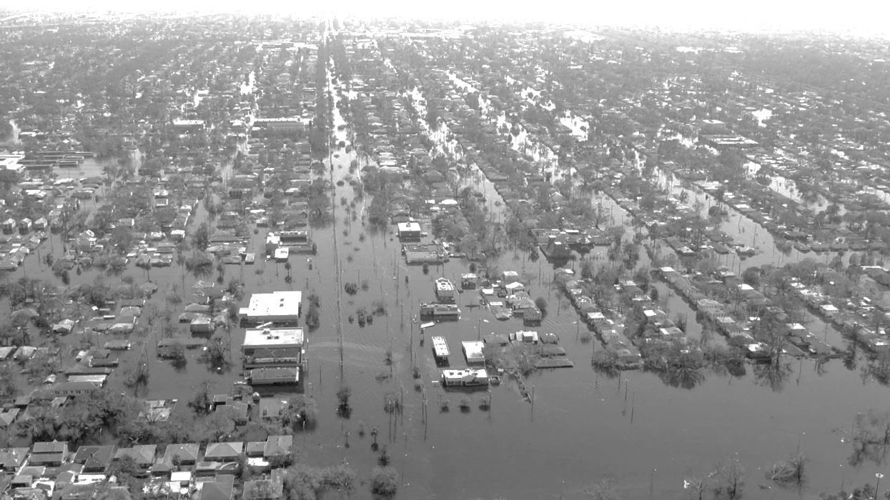
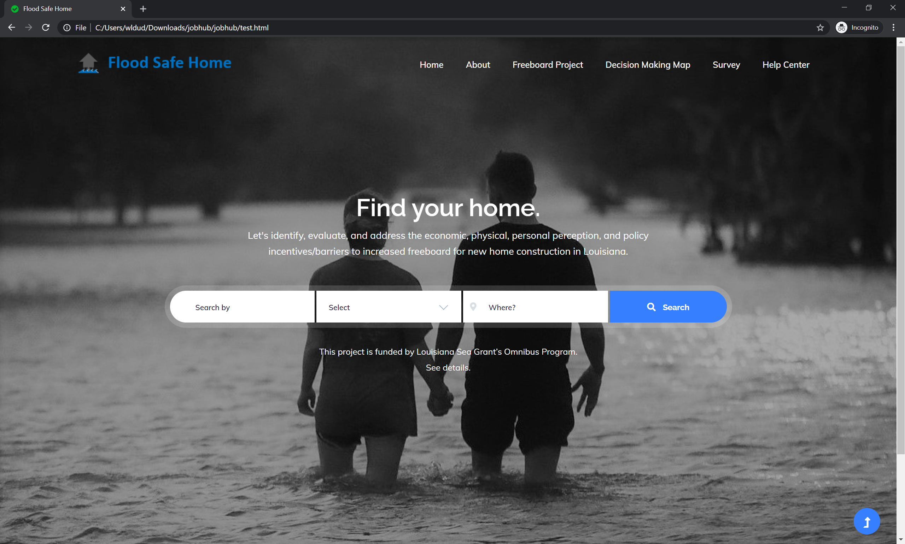

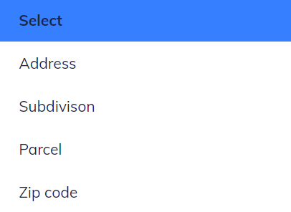

AR Web Portal
XR
Global Flood Equity

Slide 3

Back-End_ArcGIS Enterprise
ArcGIS Enterprise is the foundational software system for GIS, powering mapping and visualization, analytics, and data management. It is tightly integrated with ArcGIS Desktop, ArcGIS Pro and ArcGIS Online.
ArcGIS
Web Adaptor
=
Portal
for ArcGIS
ArcGIS Enterprise
ArcGIS
Server
ArcGIS
Data Store

Slide 4



Front-End Plans_Web-Based Maps
IIS with ArcGIS Web Adaptor
AR Web Server
ArcGIS Server
GIS Server
IBM Watson Assistant
& Watson Studio
ArcGIS Data Store
Database

Slide 5
Back-End: Flood Risk Database
_Flood hazard(address/parcel, annual chance, duration):
{
Calculate probability;
Return probability;
}
_Generate a table
_Pass the table to front end

Slide 6
Back-End_Recommendation Engine
_Calculating freeboard Elevation construction cost:
Construction cost( address/Building/Parcel, #storeys, foundation type, square footage):
{
Output= Building cost/sf *Building sf * freeboard % increase
Return output
}
Write code for the table X (Methodology)
Write QUERY in data:
Input 1=> zone and BFE
Match with zone and BFE in the table
Look up the value
User input
Use ArcGIS API for/ write QUERY in data :
Input 1 =>Lattitude-longitude or parish info in LA
Write QUERY in data:
Parish info => Get/calculate building cost

Slide 7
Back-End_Recommendation Engine
_Calculating Insurance premium:
Insurance premium( address/building/parcel, #storeys, foundation type, square footage):
{
Step 1: write QUERY in data: input 1 => BFE (100 years flood depth)
Step 2: write QUERY in data: input 1 => Flood Zone (A or V Zone)
Step 3: write code for table 6 (Methodology)
Step 4: Match BFE and Flood Zone to look up in table 6 (Methodology)
Step 5: Return insurance premium value
}

Slide 8
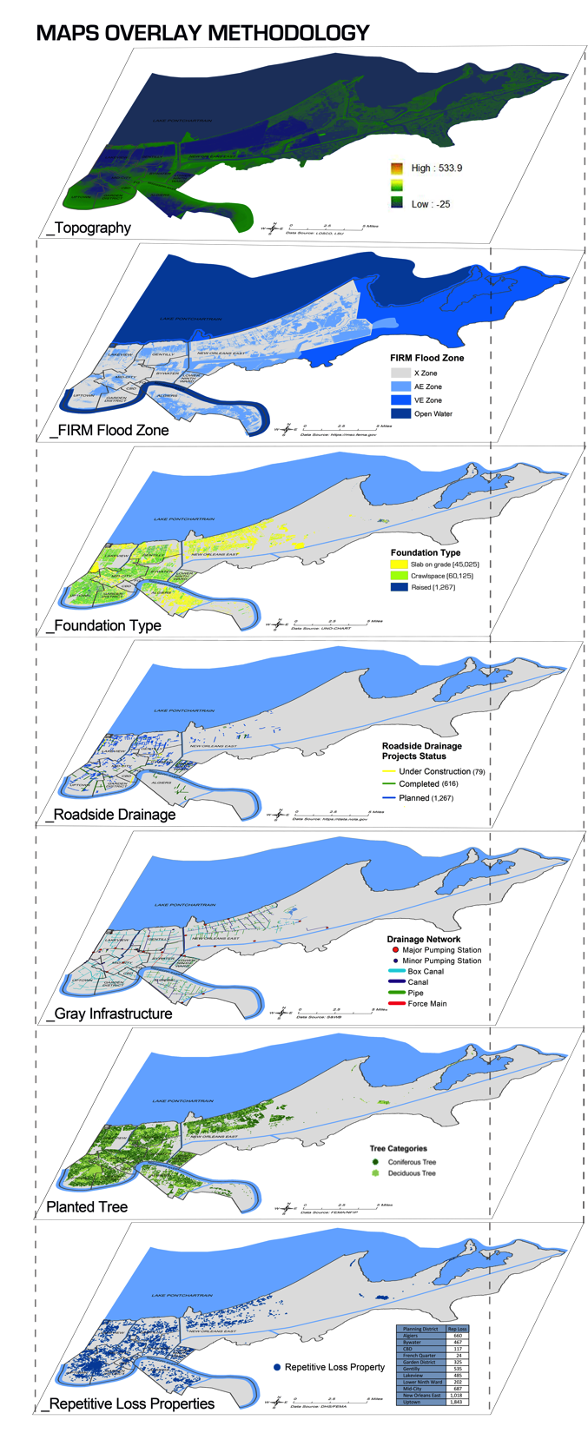
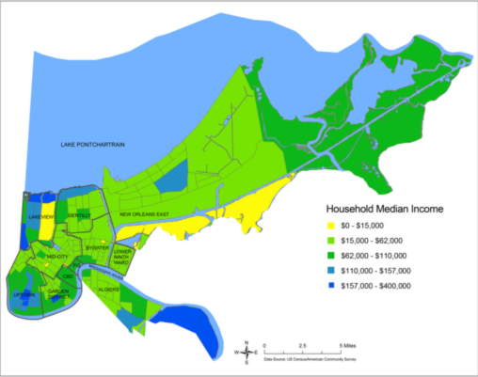
Back-End _GIS Database Focus on Environmental Justice & Equity Framework
_Methods / Functions
_Household Median Income
_Topography
_FIRM
_Foundation Type
_Road Drainage
_Gray Infrastructure
_Planted Tree
_Rep Loss Properties

Slide 9
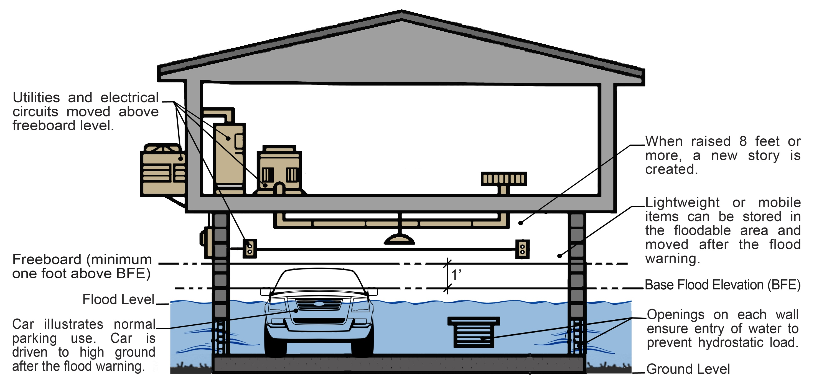
Back-End_Mitigation Database
_Methods / Functions
_Insurance
_Elevation
_Reconstruction
_Barriers
_Dry floodproofing
_Wet floodproofing
_Drainage maintenance
_Green infrastructure

Slide 10
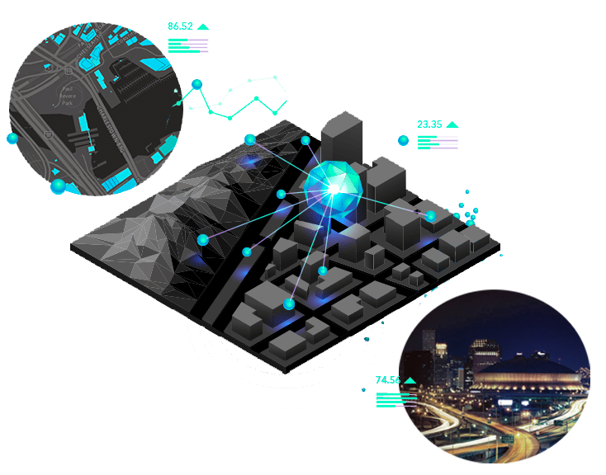
Back-End_Cost-Benefit Analysis Data
_Methods / Functions
_Construction cost
_Insurance premium
_AAL
_Net benefit (NB)
_Net benefit to cost ratio (NBCR)
_Payback periods
_Freeboard and benefit graph

Slide 11
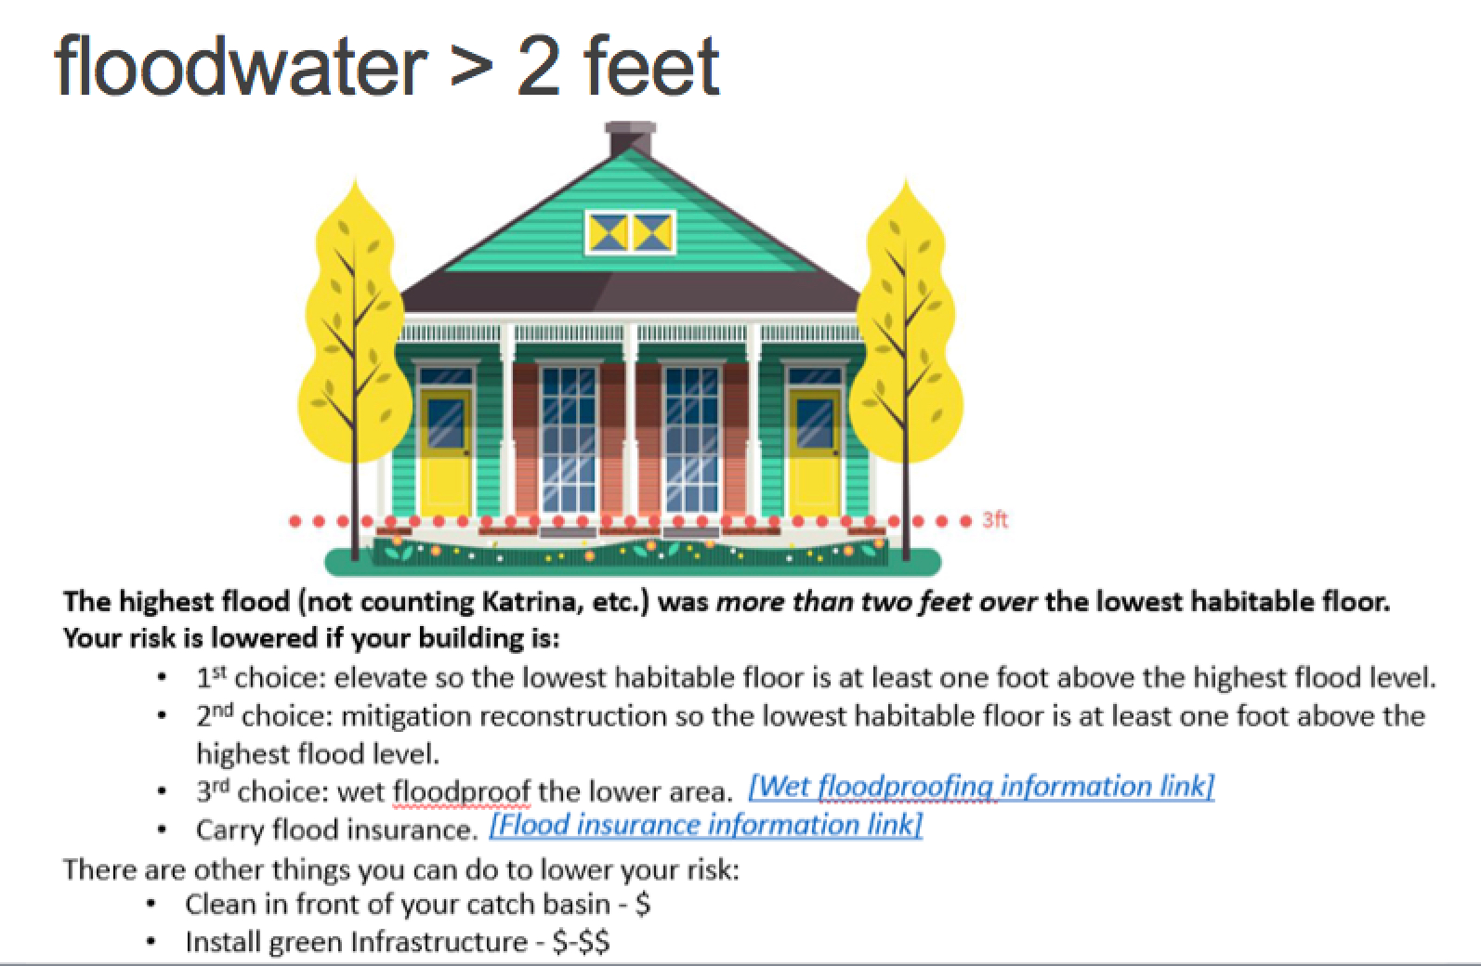
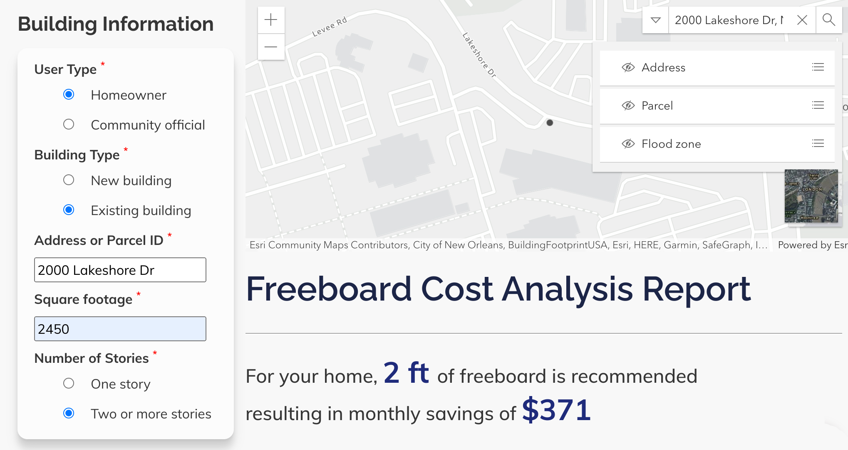
Lesson Learned from Applied Research

Slide 12
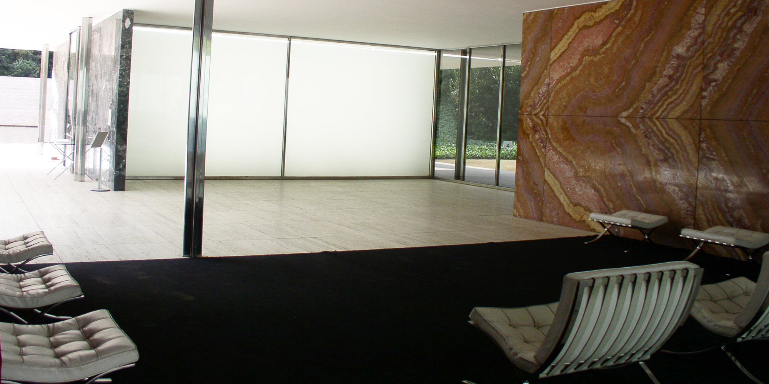

AR Web Portal
2000 Lakeshore Dr.
XR
Global Flood Equity

Slide 13
Reality

Slide 14

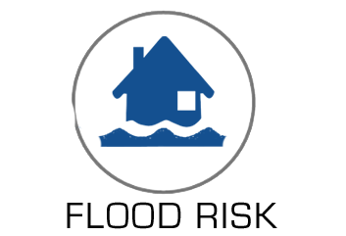
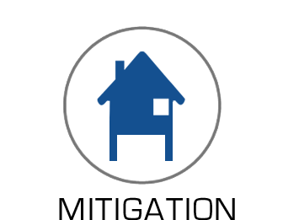


Augmented Reality

Slide 15
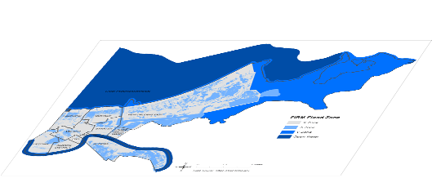
Augmented Reality
FIRM

Slide 16

Augmented Reality
FLOOD ZONE A _ SFHA
1% _ 100-YEAR FLOOD

Slide 17
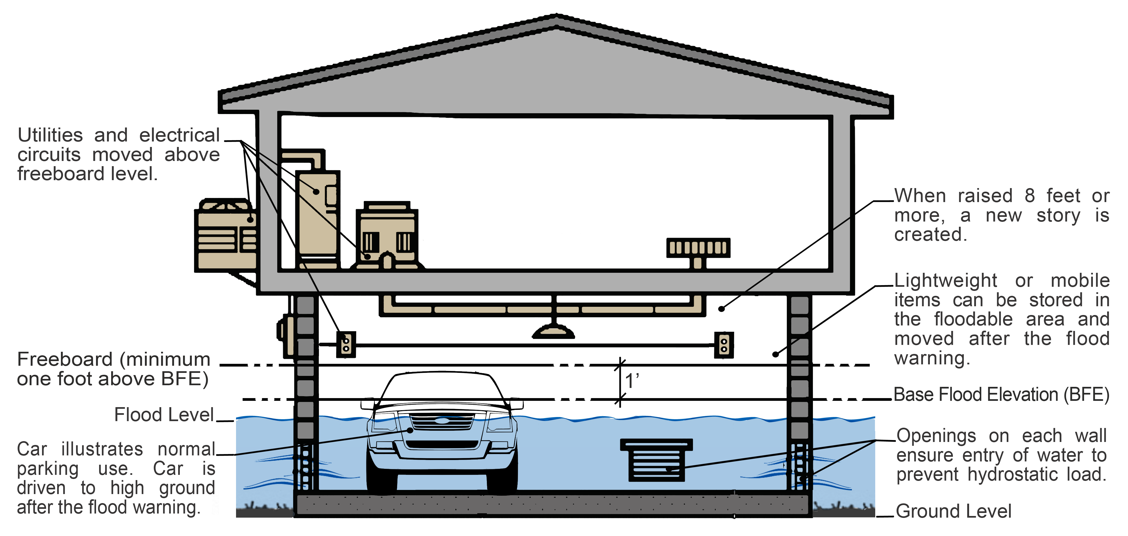
Augmented Reality
WET FLOODPROOFING

Slide 18
Thank you!

